Slide 1
Investor Pitch Template Suggested format to keep investors happy and awake.

Slide 2
Investor Pitch Template
You are SELLING not explaining.
Must “grab” in first 2 minutes, 3 slides.
Your spouse should be able to give this pitch.
NOTE
Average entrepreneur pitch – 38 slides
Average VC attention span – 12 slides, 15 minutes
Centre4Growth

Slide 3
Executive Summary
“New Co.” is what you are specializing in doing for specific customers.
Our special sauce gives us a unique advantage that will capture X% of $X market.
We will be looking for $X to build an enabling function that will generate $X over X months.
<20% of presenters do this well

Slide 4
The Problem
Describe the problem in simple, clear, concise terms.
Current state & seriousness of problem.
Desired future state, benefit to customer.
Scale of the initial market (use extra slide if necessary).
No more than 6 bullets.
Graphics better than words.
< 10% of presenters do this well
Centre4Growth

Slide 5
Your Solution
Describe your solution in simple, clear, concise terms.
Key benefits, features.
Product roadmap.
No more than 6 bullets.
Graphics better than words.
> 70% of presenters do this well
Better slot
Centre4Growth

Slide 6
The Business Model
Explain how you are going to make money - clear, concise
(If you can’t describe your business model in 20 words or less, you probably don’t have a workable model).
What’s the value to the customer?
Customer Value = (Seriousness of Current State + Benefits of Desired Future State) ­ - Cost of the Solution
Bottom up is better than top down
< 10% of presenters to this well
Centre4Growth

Slide 7
What is Your Special Sauce?
What’s the proprietary, underlying “magic” that gives you a clear, defensible advantage?
Patents on their own are rarely sufficient.
What are you going to do particularly well that it will be difficult to copy? Your “unfair advantage”.
Graphics better than words.
<30% of presenters do this well
Only New Co. can make this part.
Centre4Growth

Slide 8
How are you going to Market and Sell?
Describe your Marketing & Sales strategies in simple, clear, concise terms.
1 or 2 marketing strategies.
Sales cycle & strategy for initial market.
No more than 6 bullets.
Graphics better than words.
< 50% of presenters do this well
2 For 1 If You Buy Online!
Centre4Growth

Slide 9
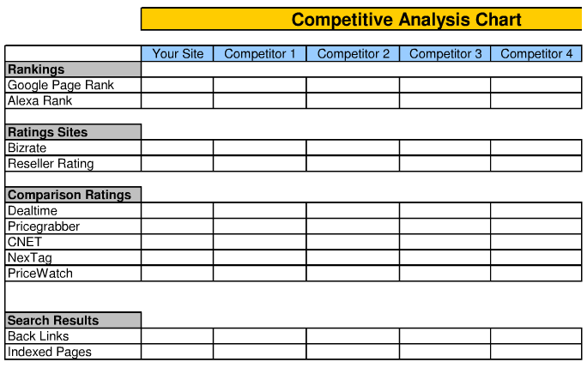
Competition
There is ALWAYS competition – even if it’s the way it’s done now.
Provide a Competitive Analysis: a table/chart
comparing your solution to the current approach & major competitors, by key benefit.
The more realistic you are, the more believable your case.
< 30% of presenters
do this well
Centre4Growth

Slide 10
Who’s on the Team?
Management Team
Why is this the Right Team?
Relevant information only - shorter is better
Accomplishments better than company names
include independent Directors, if relevant
Identify holes that will need to be filled
< 10% of presenters do this well
Centre4Growth

Slide 11
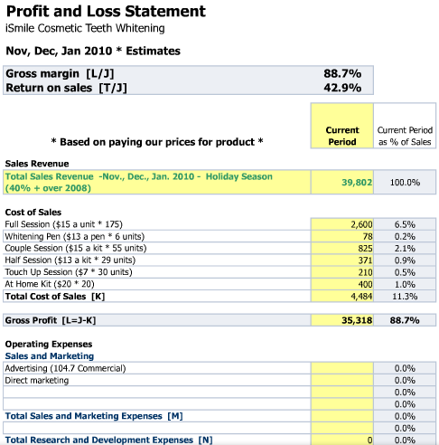
Financial Projections
Profit and Loss Statement
Bottom up better than top down.
Assumptions more important than numbers.
Be prepared to explain.
< 10% of presenters do this well
Centre4Growth

Slide 12
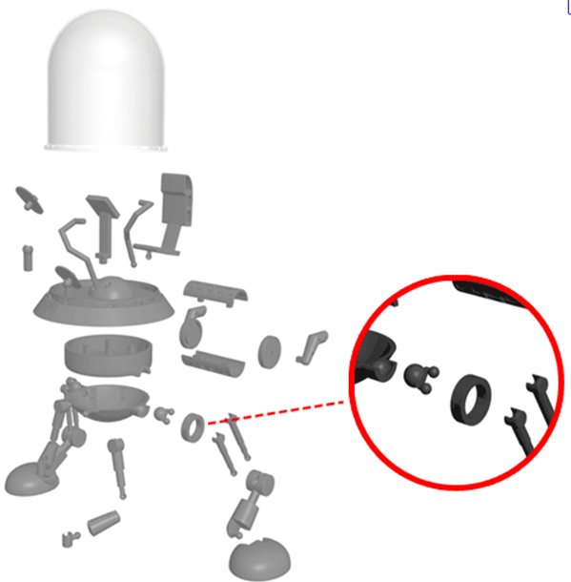
Status and Timeline
Major Milestones:
What’s been achieved to date.
What you’re going to use the money for.
When you expect to break even.
Any additional funding.
Include expected liquidity event & potential buyers.
<30% of presenters do this well
Completed for $100,000 June 2008
Need $1 M to Complete by
May 2012
Centre4Growth

Slide 13
Summary
The top 2 or 3 things you want audience to remember
No more than 3 bullets
Most presenters don’t do this
at all

Slide 14
Appendices
Have details ready for when you are asked.
a) team biographies.
b) technical details including product stage timeline and regulatory issues.
c) market research conducted.
d) competition.
e) sales and marketing.
f) financials including funding history.
g) location of the company and why.
h) intellectual property details.
Centre4Growth

